Slide 1
Module 4
Relational Data Model

Slide 2
Relational model
The relational model is a fundamental concept in database management systems (DBMS). Let’s delve into its key components and understand how it organizes and manages data:
Definition:
  The relational model, proposed by Edgar F. Codd, represents data using tables (also known as relations). These tables consist of rows (called tuples) and columns (representing attributes).
  Each table has a unique name and corresponds to a specific entity or concept in the database.

Slide 3
Terminology:
  Attribute: Attributes define the properties of an entity.
  For example, in a table representing students, attributes
  could include roll number, name, address, phone, and age.
  Relation Schema: A relation schema defines the structure
  of a table, specifying its name and attributes. For instance,
  the relation schema for a student table might be
  (ROLL_NO, NAME, ADDRESS, PHONE, AGE).
  Tuple: Each row in a table is a tuple. In our student table,
  each student record is a tuple.

Slide 4
  Relation Instance: The set of tuples in a table at a specific moment constitutes a relation instance. It can change due to insertions, deletions, or updates.
  Degree: The number of attributes in a relation defines its degree. Our student relation has a degree of 5.
  Cardinality: The number of tuples in a relation is its cardinality. Our student relation has a cardinality of 4.
  Column: Columns represent the values of a specific attribute. For example, the column “ROLL_NO” contains roll numbers.
  NULL Values: When a value is unknown or unavailable, it is represented as NULL (e.g., a student’s phone number might be NULL).
  Relation Key: Keys uniquely identify rows or help identify tables.

Slide 5
Advantages:
  Efficient Data Management: The relational model organizes data into tables, making it easier to manage, retrieve, and analyze.
  Structured Format: Data is structured into rows and columns, facilitating logical organization.
  Widely Used: Most current database systems are based on the relational model.

Slide 6
Integrity Constraints
Integrity constraints are a set of rules. It is used to maintain the quality of information.
Integrity constraints ensure that the data insertion, updating, and other processes have to be performed in such a way that data integrity is not affected.
Thus, integrity constraint is used to guard against accidental damage to the database.

Slide 7
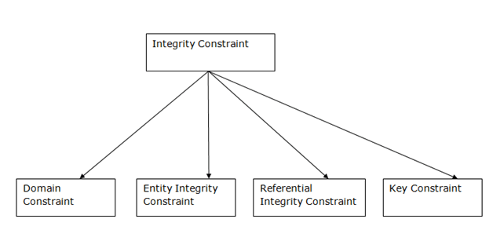
Types of Integrity Constraint

Slide 8
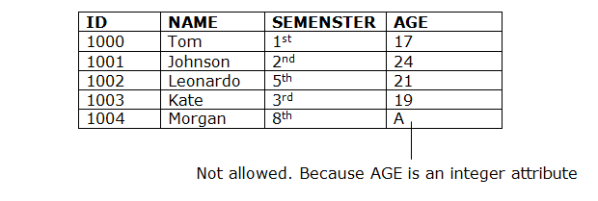
Example:
1. Domain constraints
Domain constraints can be defined as the definition of a valid set of values for an attribute.
The data type of domain includes string, character, integer, time, date, currency, etc. The value of the attribute must be available in the corresponding domain.
EXAMPLE:

Slide 9
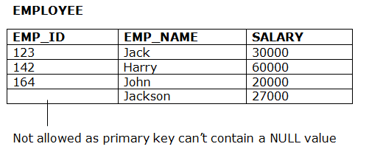
2. Entity integrity constraints
The entity integrity constraint states that primary key value can't be null.
This is because the primary key value is used to identify individual rows in relation and if the primary key has a null value, then we can't identify those rows.
A table can contain a null value other than the primary key field.
Example:

Slide 10
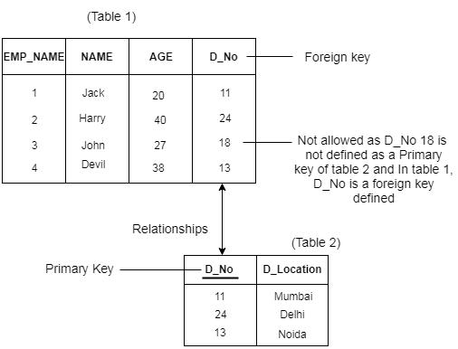
3. Referential Integrity Constraints
A referential integrity constraint is specified between two tables.
In the Referential integrity constraints, if a foreign key in Table 1 refers to the Primary Key of Table 2, then every value of the Foreign Key in Table 1 must be null or be available in Table 2.
Example:

Slide 11
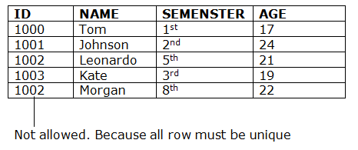
4. Key constraints
Keys are the entity set that is used to identify an entity within its entity set uniquely.
An entity set can have multiple keys, but out of which one key will be the primary key. A primary key can contain a unique and null value in the relational table.
Example:

Slide 12
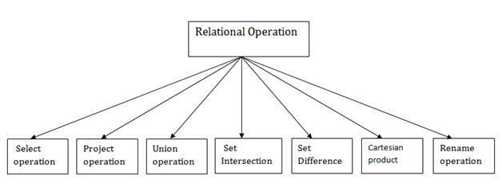
Relational Algebra
Relational algebra is a procedural query language. It gives a step by step process to obtain the result of the query. It uses operators to perform queries.
Types of Relational operation

Slide 13
1. Select Operation:
The select operation selects tuples that satisfy a given predicate.
It is denoted by sigma (σ).
Notation: σ p(r)
σ: is used for selection prediction
r:is used for relation
p :is used as a propositional logic formula which may use connectors like: AND OR and NOT. These relational can use as relational operators like =, ≠, ≥, <, >, ≤.

Slide 14
For example −
σ_{subject = "database"}(Books)
Output − Selects tuples from books where subject is 'database'.
σsubject = "database" and price = "450"(Books)
Output − Selects tuples from books where subject is 'database' and 'price' is 450.
σsubject = "database" and price = "450" or year > "2010"(Books)
Output − Selects tuples from books where subject is 'database' and 'price' is 450 or those books published after 2010.
Select * from books where subject=‘database’ and price=450 or year>’2010’

Slide 15
2.Project Operation (∏):
It projects column(s) that satisfy a given predicate.
Notation − ∏_{A1, A2, An} (r)
Where A₁, A₂ , A_{n} are attribute names of relation r.
Duplicate rows are automatically eliminated, as relation is a set.
For example −
∏_{subject, author} (Books)
Selects and projects columns named as subject and author from the relation Books.
SQL Query:
Select distinct subject,author from books;

Slide 16
3.Union Operation (∪)
It performs binary union between two given relations and is defined as −
r ∪ s = { t | t ∈ r or t ∈ s}
Notation − r U s
Where r and s are either database relations or relation result set (temporary relation).
For a union operation to be valid, the following conditions must hold −
r, and s must have the same number of attributes.
Attribute domains must be compatible.
Duplicate tuples are automatically eliminated.
∏ _{author} (Books) ∪ ∏ _{author} (Articles)
Output − Projects the names of the authors who have either written a book or an article or both.

Slide 17
Example:
Select author from books UNION select author from articles;
The UNION operator selects only distinct values by default.
To allow duplicate values use UNION ALL.
Select author from books UNION ALL select author from articles;

Slide 18
4.Set Difference (−)
The result of set difference operation is tuples, which are present in one relation but are not in the second relation.
Notation − r − s
Finds all the tuples that are present in r but not in s.
∏ _{author} (Books) − ∏ _{author} (Articles)
Output − Provides the name of authors who have written books but not articles.
EXAMPLE:
Select author from books MINUS select author from article;

Slide 19
5.Cartesian Product (Χ)
The CARTESIAN JOIN is also known as CROSS JOIN. In a CARTESIAN JOIN there is a join for each row of one table to every row of another table. This usually happens when the matching column or WHERE condition is not specified. In the absence of a WHERE condition the CARTESIAN JOIN will behave like a CARTESIAN PRODUCT . i.e., the number of rows in the result-set is the product of the number of rows of the two tables.
In the presence of WHERE condition this JOIN will function like a INNER JOIN.
Combines information of two different relations into one.
Notation − r Χ s
Where r and s are relations and their output will be defined as −
r Χ s = { q t | q ∈ r and t ∈ s}
σ_{author = ‘rames elmasri'}(Books Χ Articles)

Slide 20
Output − Yields a relation, which shows all the books and articles written by ‘rames elmasri’.
Example :
Select * from books CROSS JOIN articles where author=‘rames almasri’

Slide 21
6.Rename Operation (ρ)
The results of relational algebra are also relations but without any name. The rename operation allows us to rename the output relation. 'rename' operation is denoted with small Greek letter rho ρ.
Notation − ρ _{x} (E)
Where the result of expression E is saved with name of x.
EXAMPLE:
Alter table books rename to Subject_Books varchar(145);

Slide 22
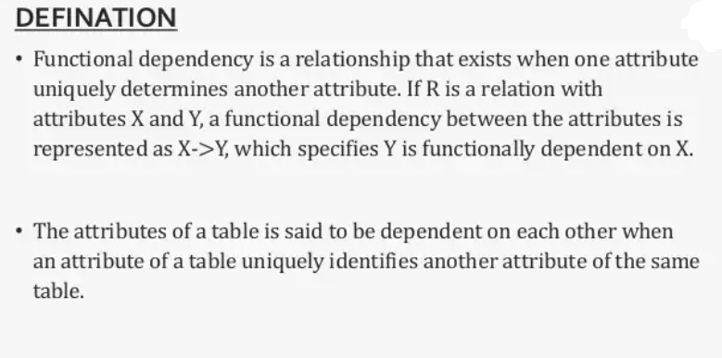
Functional Dependancy

Slide 23
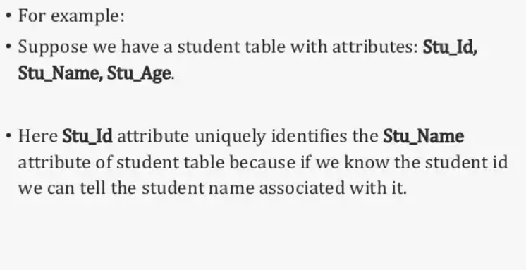
S_ID | S_name
1 | Ram
2 | Varun
S_Id | S_name
1 | Ram
2 | Ram
S_Id | S_name
1 | Ram
1 | Ram

Slide 24
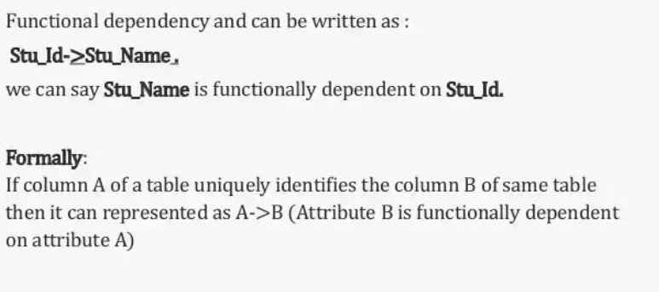

Slide 25
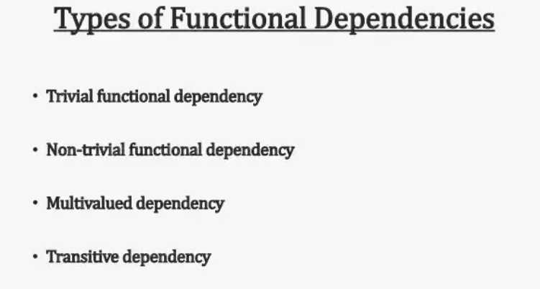

Slide 26
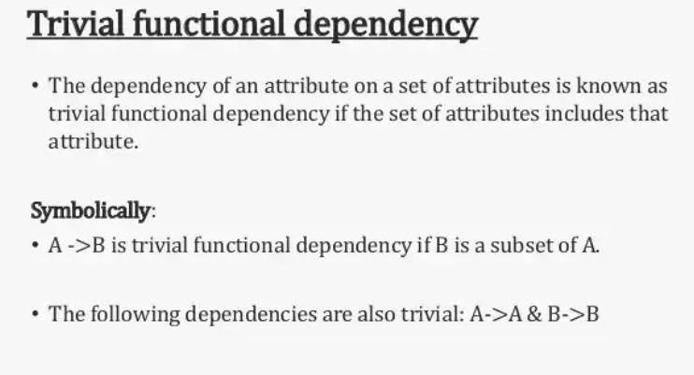

Slide 27
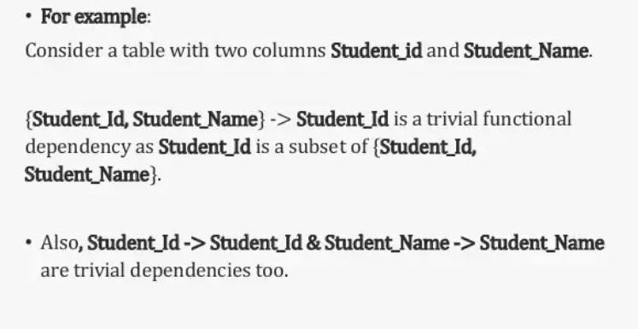

Slide 28
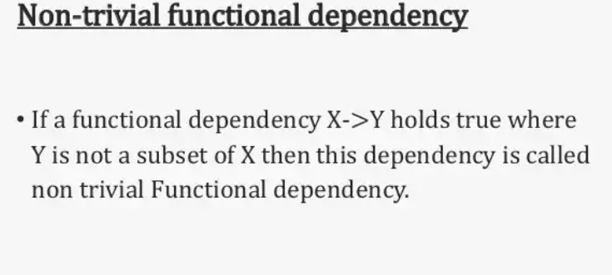

Slide 29
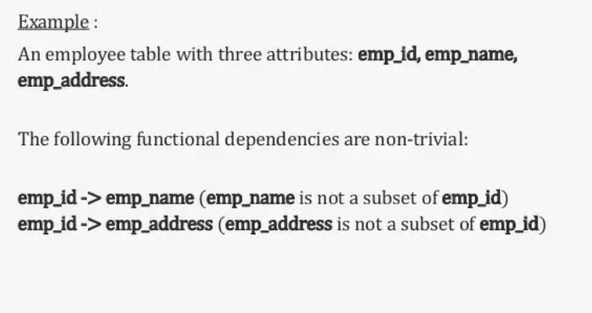

Slide 30
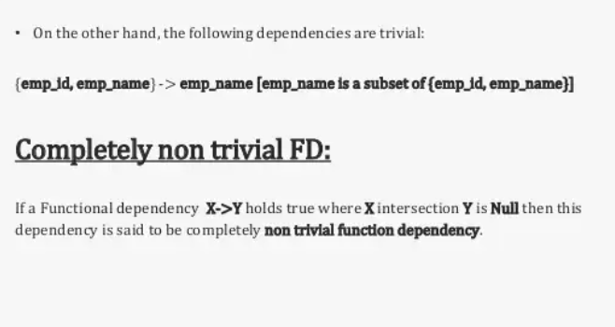

Slide 31
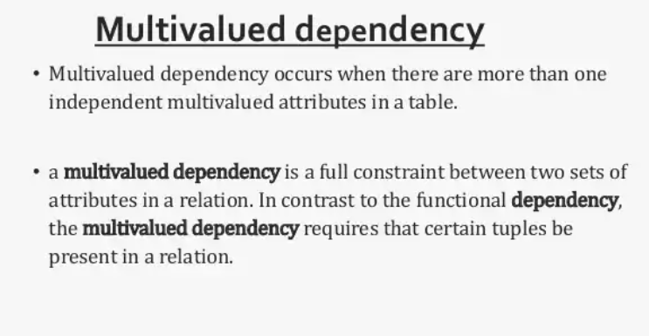

Slide 32
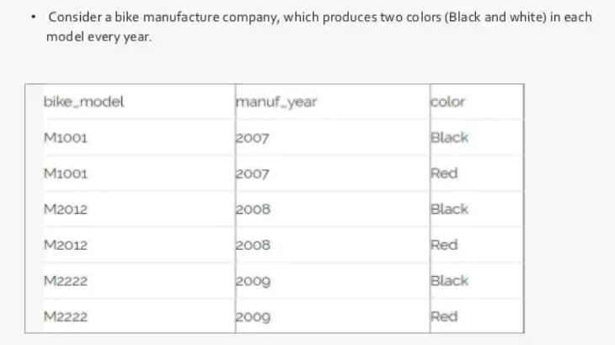

Slide 33
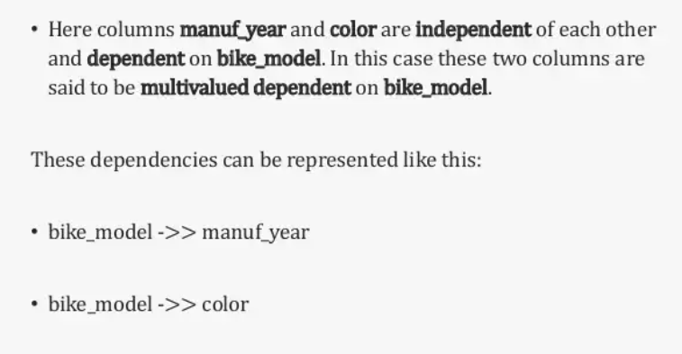

Slide 34
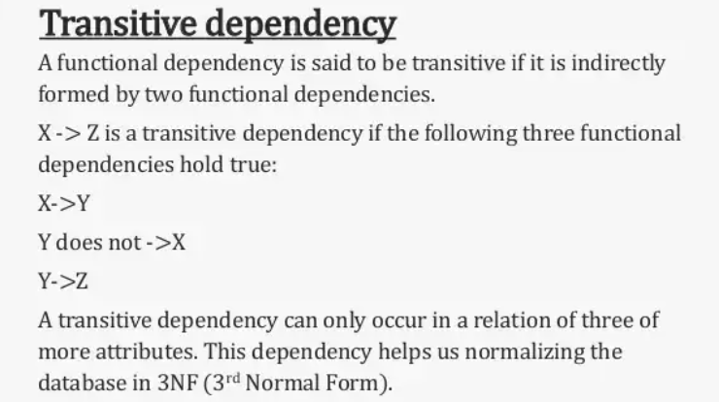

Slide 35
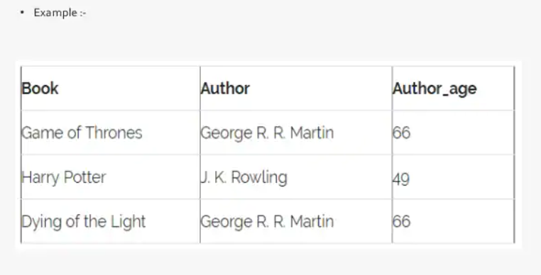

Slide 36
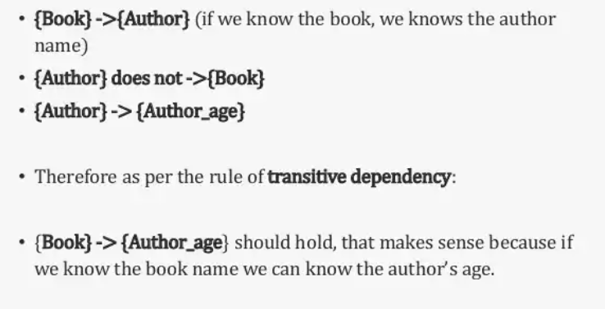

Slide 37
Armstrong's axioms
The Armstrong's axioms are the basic inference rule.
2.Armstrong's axioms are used to conclude functional dependencies on a relational database.
3.The inference rule is a type of assertion. It can apply to a set of FD(functional dependency) to derive other FD.
4.Using the inference rule, we can derive additional functional dependency from the initial set.

Slide 38
The Functional dependency has 6 types of inference rule:
Reflexive Rule
In the reflexive rule, if Y is a subset of X, then X determines Y.
If X ⊇ Y then X → Y
Example:
X = {a, b, c, d, e}
Y = {a, b, c}

Slide 39
2.Augmentation Rule
The augmentation is also called as a partial dependency. In augmentation, if X determines Y, then XZ determines YZ for any Z.
If X → Y then XZ → YZ
Example:
For R(ABCD), if A → B then AC → BC

Slide 40
3.Transitive Rule
3.Transitive Rule
In the transitive rule, if X determines Y and Y determine Z, then X must also determine Z.
If X → Y and Y → Z then X → Z
In the transitive rule, if X determines Y and Y determine Z, then X must also determine Z.
If X → Y and Y → Z then X → Z

Slide 41
4.Union Rule
Union rule says, if X determines Y and X determines Z, then X must also determine Y and Z.
If X → Y and X → Z then X → YZ

Slide 42
5.Decomposition Rule
Decomposition rule is also known as project rule. It is the reverse of union rule.
This Rule says, if X determines Y and Z, then X determines Y and X determines Z separately.
If X → YZ then X → Y and X → Z

Slide 43
6.Pseudo transitive Rule
In Pseudo transitive Rule, if X determines Y and YZ determines W, then XZ determines W.
If X → Y and YZ → W then XZ → W

